Slide 1

Statistical arbitrage
Applied deep learning
Martina Danese 12108361

Slide 2



Introduction to
Statistical Arbitrage
Approach
Results
2

Slide 3
Introduction to
Statistical Arbitrage
Approach
Results
3

Slide 4

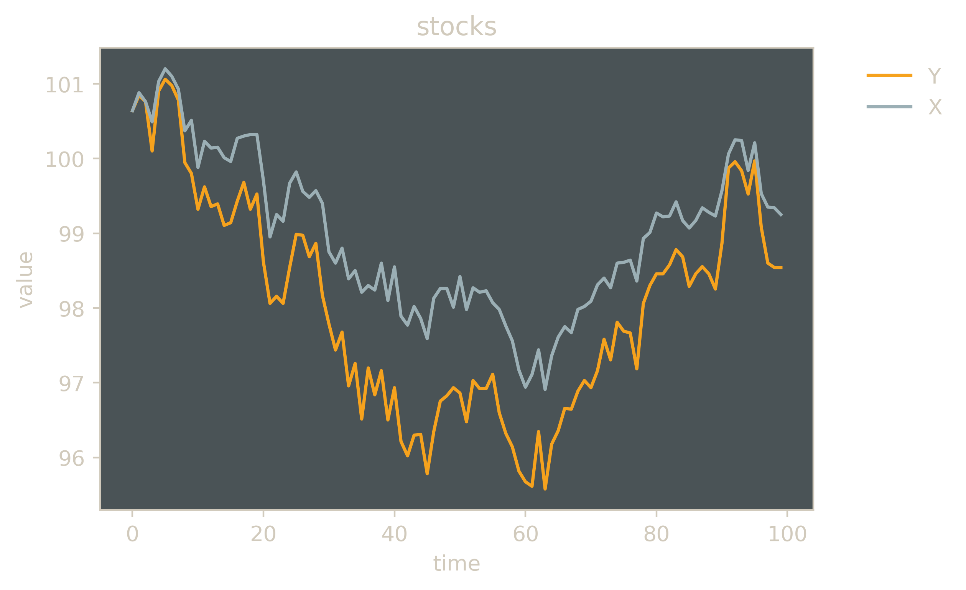
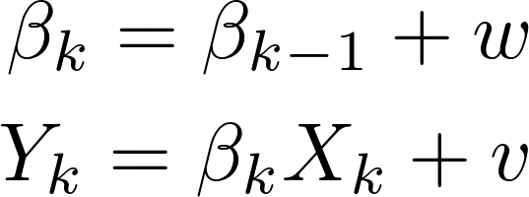
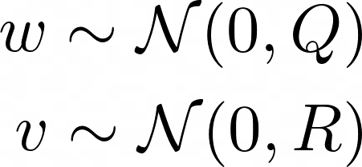
Statistical arbitrage
Toy example:
Extract the time-series signals of a portfolio of similar assets;
Capture temporary price deviations of single stocks from the time-series trend, considered as correct pricing;
Apply a profitable trading policy, longing on (buying) one or more stocks and shorting on (selling) an equal amount according to the direction of spread of the assets.
observed processes of stock prices
The separation between the quoted price from the true price can be computed:
With a larger portfolio we want to daily identify the set of 10 most profitable and of the 10 less profitable stocks, in order to long on the firsts and short on the latter.
4

Slide 5

Introduction to
Statistical Arbitrage
Approach
Results
5

Slide 6
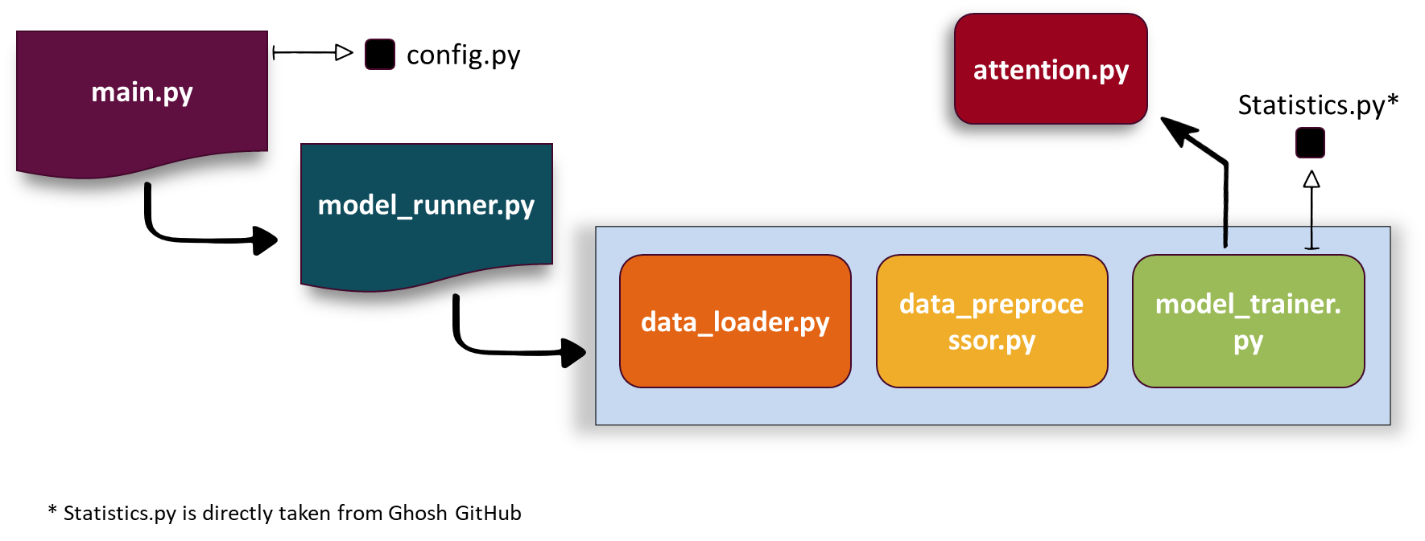
IMPLEMENTATION PIPELINE
6
6

Slide 7
Introduction to
Statistical Arbitrage
Approach
Results
7

Slide 8


daily return
only LSTM*
0.64% (0.61%)
Luong Attention
<0.40%
Bahdanau Attention
0.66%
Bahdanau results obtained with
half of the original features
Ghosh, P., Neufeld, A., & Sahoo, J. K. (2021). Forecasting directional movements of stock prices for intraday trading using LSTM and random forests. Finance Research Letters, 102280.

Slide 9



DEMO

Slide 10

insights
Data collecting and preprocessing will probably take more than I expect;
A smart architecture allows for less features in the model;
Default Keras options are not always the best;

